Slide 1

Enhancing Search and Rescue Operations: A Pragmatic Application of User-Centered Development
Tyler Choi, MSc in Computer Science & Software Engineering
University of Washington Bothell
May 30, 2023
Chair: Dr. Kelvin Sung
Committee: Dr. Michael Stiber, Dr. Yusuf Pisan

Slide 2



Contents
Introduction
Background
First Project: VR Topographical System
Second Project: GUI/CLI
User-Centered Design Approach
Solution Process
User Results
Conclusion
Q&A

Slide 3


Introduction
VR ITM
SAR GUI/CLI
1
5
2
3
4
September 2022
May
2023
UCD Pivot

Slide 4
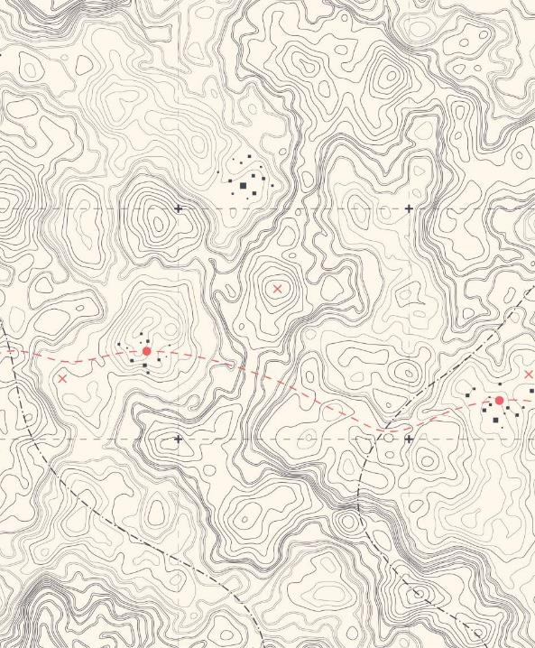
Background
Goal: Tool for mission critical frontline personnel
Forest Fire Fighter
Remote Search and Rescuers
How?
Virtual Reality Interactive Topographical Mapping System

Slide 5
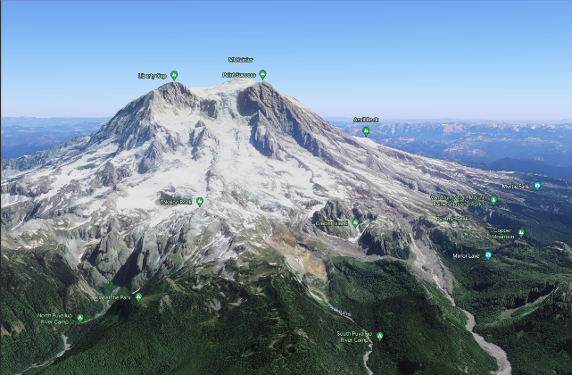
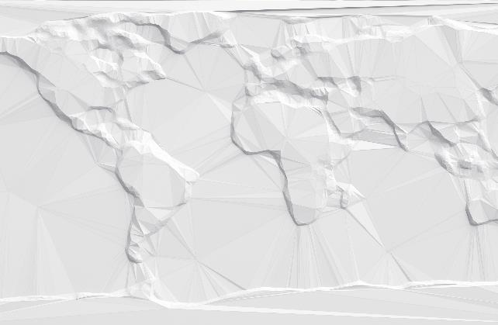
Interactive Topographical Mapping (ITM) System
Real-time, interactive 3D visualizations of terrains based on Digital Elevation Models (DEMs)

Slide 6
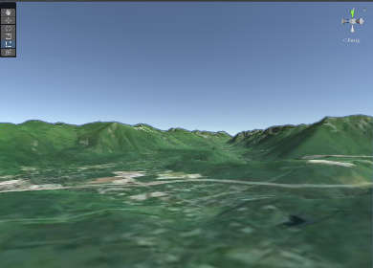
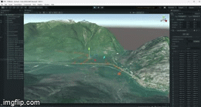
Digital Elevation Models
Visual representation of the Earth's surface, including information about the shape and elevation of the terrain

Slide 7
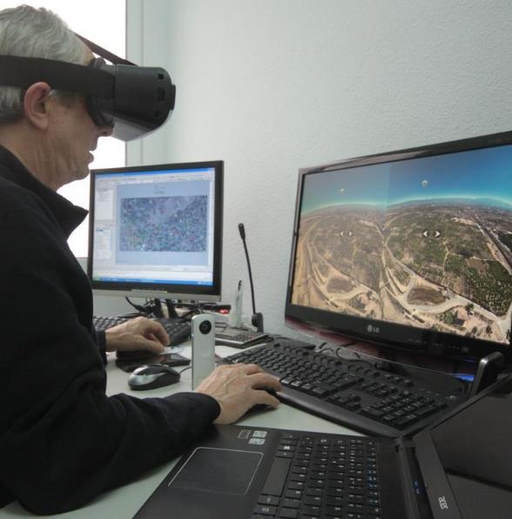
Existing Terrain Visualization Systems
GeoVR
Limitations:
Cross-platform collaboration
GoogleVR
Real-time data processing
User-specific info augmentation
Notes:
limitations in real-time data processing, user-specific information augmentation, and cross-reality collaboration

Slide 8
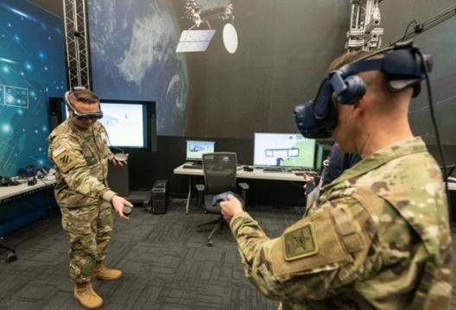
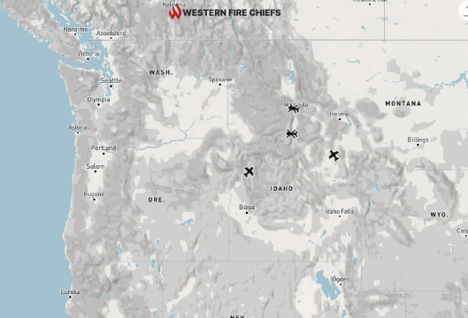
Terrain Modeling in Tactical Operations
Tactical Military operations
Wildfire response:
Wildland Fire Coordination Association's Fire Map
Notes:
https://www.defensemedianetwork.com/stories/tactical-assault-kit-meets-virtual-reality-sponsored/

Slide 9
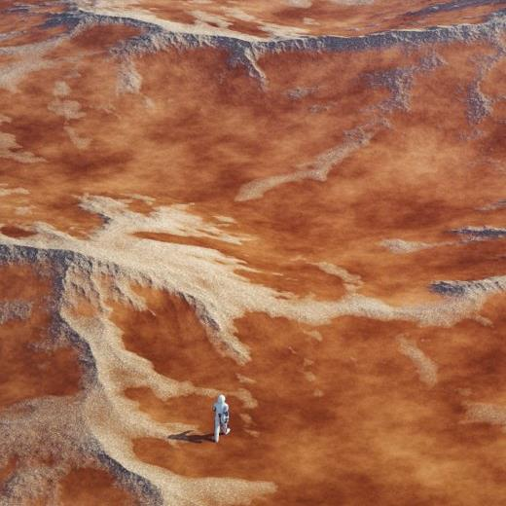
Summary and Observations (1)
Terrain visualization can become an indispensable tool in real-world scenarios
Emergency response operations
Urban planning
Environmental management
Military training

Slide 10
Progress
VR ITM
SAR GUI/CLI
1
5
2
3
4
September 2022
May
2023
UCD Pivot

Slide 11



VR System Design Specifications
Flexible Map Generation
High-Quality Rendering
Interactive Pathway Creation and Analysis
Real-time Collaborative Features
Cross-platform Support
Notes:
The system will be designed to handle DEMs of various resolutions and formats, and transform them into 3D terrains in real-time
The system will demonstrate high-performance graphics rendering capabilities
The design will accommodate an intuitive and user-friendly interface for pathway creation and analysis
To enable real-time collaboration, the system will be designed to support the simultaneous presence of multiple users
The system will be designed to be compatible with various devices and platforms, including desktops and VR headsets

Slide 12
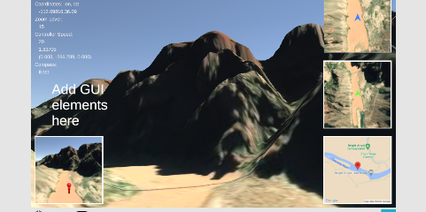
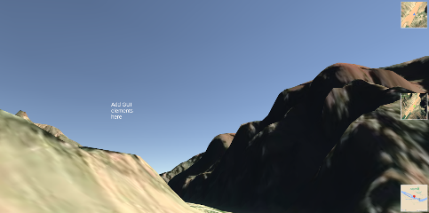
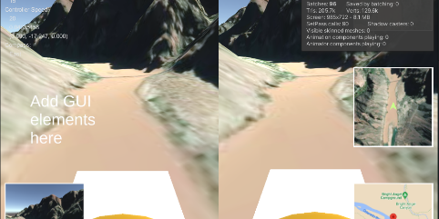
Delivered VR System
Interactive selection and display of any terrain from DEMs
Multiple camera angles: first-person, third-person, and bird's eye views
Flexible navigation: options to walk or fly over terrain
Diverse mini map styles: 3D, 2D, satellite image, and contour
Built-in compass for navigation and orientation
Versatile usage: operable with or without a VR headset on a Windows PC

Slide 13
Evaluating Project Deliverables
Interactive Map Augmentation: Successfully facilitated the creation, refinement, and analysis of terrain
Versatile Usage: Compatible with or without a VR headset on a Windows PC.

Slide 14


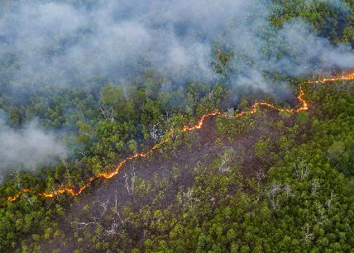
End-User Feedback and Reflection (2)
For real-life forest fire missions, the ability to verify ground and vegetation status via in-person examination is crucial
Successfully demonstrated the capacity to develop a VR ITM system
Notes:
Although the VR ITM system did not meet the needs of forest fire researchers and SAR members, it demonstrated our capacity to develop a fully functional VR ITM system using DEMs and the Unity Engine for VR development

Slide 15
Progress
VR ITM
SAR GUI/CLI
1
5
2
3
4
September 2022
May
2023
UCD Pivot

Slide 16
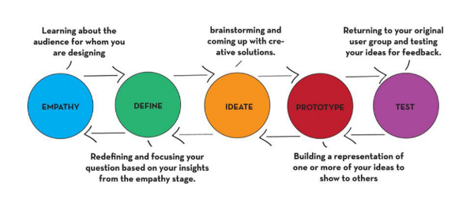
User Centered Design Pivot
Benefits of User-Centered Design
Enhanced user satisfaction and improved efficiency.
Increased user adoption and reduced the need for extensive training.
Notes:
Empathy: Understand users, their needs, and contexts.
Define: Clearly articulate the users' needs, goals, and pain points.
Ideate: Brainstorm and explore a wide range of creative solutions.
Prototype: Create a tangible representation of selected ideas.
Test: Validate the solution against user needs through user testing.

Slide 17
User-Centered Design Approach: Overview and Project Goals
Practice Collecting: Gather valuable insights from end-users
UI Evolution: Develop an interface that is intuitive, user-friendly, and tailored
Software Usability
Software Testing: Rigorous testing of the software at each stage of development
Software Delivery: Ensure timely and efficient delivery of the software
Notes:
through interviews, surveys, and observation of their workflows
, while allowing for iterative improvements

Slide 18
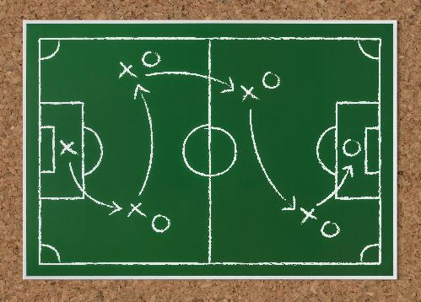
UCD Pivot Reflections (3)
This strategic pivot, prompted by end-user feedback, underscores the importance of:
Ensuring that project goals align with end-user needs
Notes:
This transformation, which permeates the entire second phase of the project, culminates in the creation of a software solution that is not only technologically versatile but also provides a practical and beneficial tool for SAR personnel

Slide 19
Progress
VR ITM
SAR GUI/CLI
1
5
2
3
4
September 2022
May
2023
UCD Pivot

Slide 20


Search and Rescue (SAR)
SAR?
Lifesaving operations in challenging environments.
Mission Flow:
Plan -> Execute -> Review -> Update
Applied Search Theory:
Field data guides efficient resource allocation.
Key Challenges:
Multi-day remote missions, limited connectivity, slow manual processes.
Notes:
What is SAR?
SAR (Search and Rescue) operations are carried out to find and aid individuals in distress or danger, often in challenging environments.
SAR Mission Process:
Planning: Gathering incident data, converting information into probabilities, and mapping probabilities to allocate resources efficiently.
Execution: Deployment of teams in shifts, traversing specific areas, and gathering GPS track data.
Review & Assessment: Post-shift review to calculate distances traversed, determine area coverage, and inform planning for subsequent shifts.
Applied Search Theory: Data from field teams informs resource allocation, enhancing mission effectiveness and increasing chances of success.
Key Challenges:
Missions often span multiple days in remote areas with limited connectivity.
Speed and efficiency are crucial in these life-saving operations. Manual processes, such as calculating traversed distances, can slow down mission progression.

Slide 21
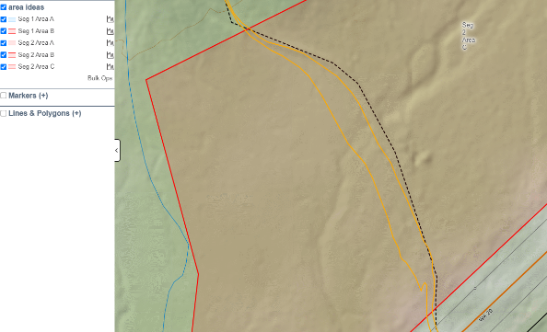
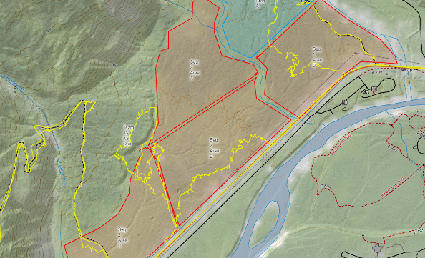
From End-User (Director, Washington State SAR Planning Unit)
Search is hindered by slow, manual processing of field team GPS tracks
Current system does not provide a simple, low-overhead, offline tool to quickly calculate total track line length (TLL)
Pain Points:
Time-consuming process to manually trim each GPS track within a search segment
Inefficiency of track processing can result in idling resources or inefficient deployment
No internet connectivity at the Command Post of a SAR mission
Increased efficiency could potentially save lives by finding lost subjects quicker

Slide 22

Problem Statement
Problem:
Manual GPS processing: time-intensive and lacks offline tool.
Limited connectivity hampers data processing.
Impact:
Resource idling, inefficient deployment, extended searches.
Solution:
Rapid, offline calculation of Total Track Line Length (TLL).
User-friendly for varied user types.

Slide 23
Solution Requirement
Simple UI
Offline Availability
Low Overhead
Speed
Utility-focused
Notes:
to facilitate easy usage even under stressful and time-sensitive situations
, as SAR command posts often operate in areas with limited or no internet connectivity
to not burden the limited computational resources available during SAR operations
to facilitate real-time decision-making
providing valuable insights and aiding in decision-making for SAR personnel

Slide 24
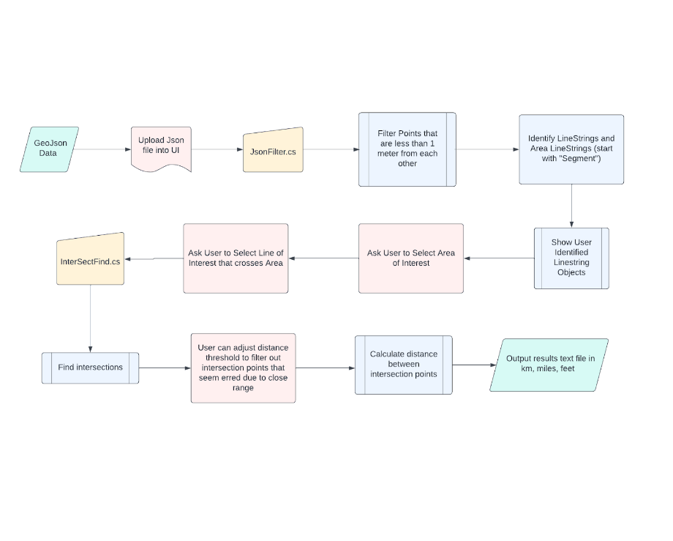
Software Solution Pipeline

Slide 25
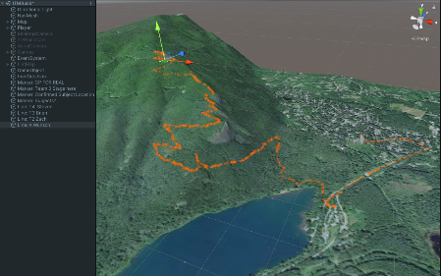
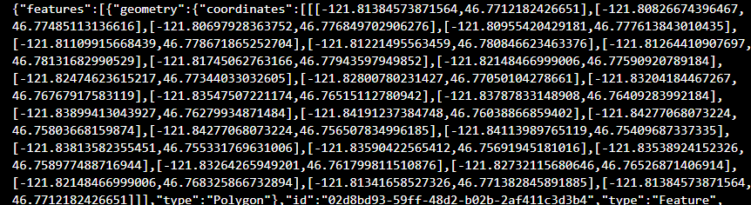
Data Filtering
Eliminate irrelevant, incorrect, or redundant data
Improves accuracy and efficiency of Search and Rescue operations
Benefits of Data Filtering:
Enhanced Accuracy
Improved Efficiency
Better Decision Making

Slide 26
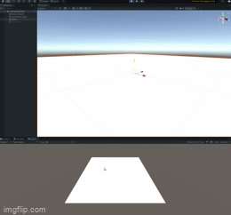
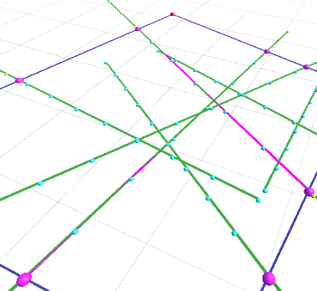
Algorithm Design
Stage 1: Initial Design & Verification
Design and verify our intersection algorithm via Unity.
Stage 2: Integration and Refactoring
Integrated to Windows Form (WinForm) via .NET.
Code reworked to adapt Unity-specific libraries to .NET.

Slide 27
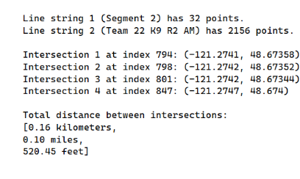
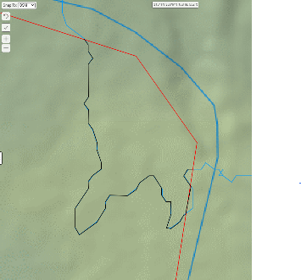
Algorithm Verification
Algorithmic computation results
VS
SarTopo manually traced results

Slide 28
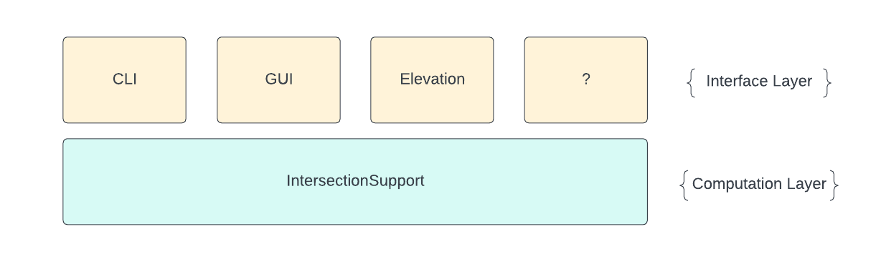
Modular Architecture
Separation of Concerns:
Each module designed for specific functionality.
Clean, manageable codebase.
High Cohesion & Low Coupling:
High internal consistency
Minimal dependency
Robustness and easier maintenance.
Notes:
Benefits
Scalability: With a modular approach, our system is easily scalable. New features or improvements can be added as separate modules without affecting the entire system.
Flexibility: Changes or updates can be implemented in a specific module without disrupting the operation of other modules. This leads to a more flexible and adaptable system.
Easier Testing & Debugging: Issues can be isolated to specific modules, making it easier to identify problems and test new solutions.

Slide 29
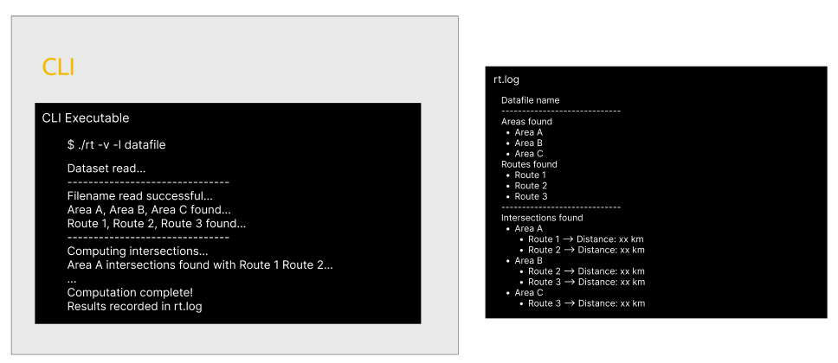
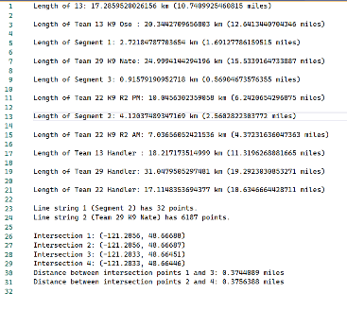
UI Evolution -- CLI

Slide 30
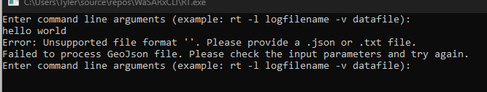
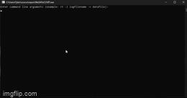
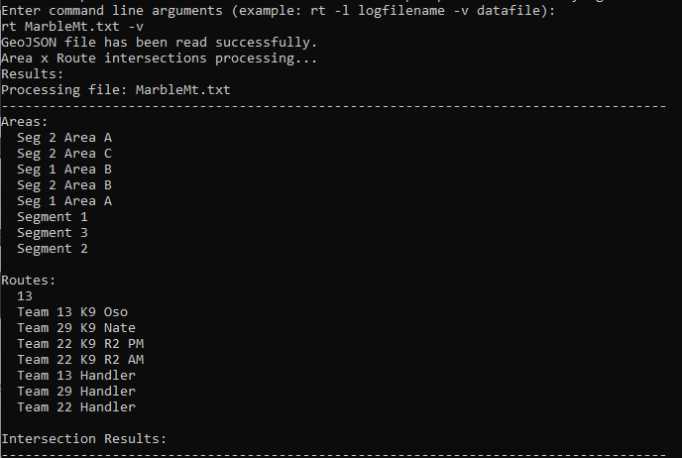
Final Deliverable -- CLI

Slide 31
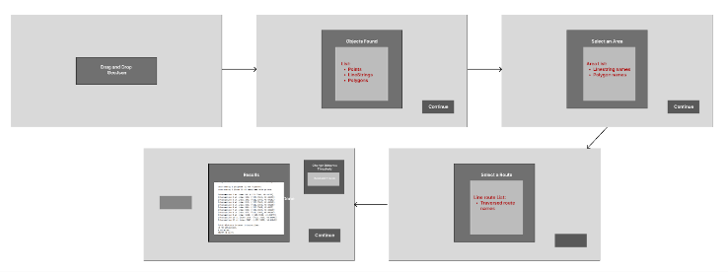
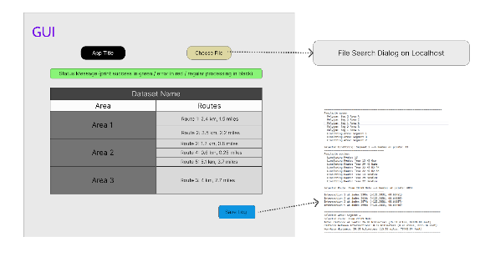
UI Evolution -- GUI

Slide 32
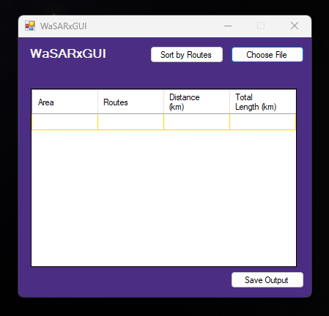
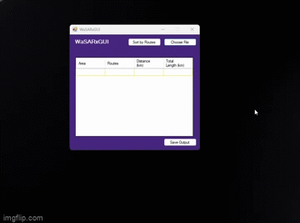
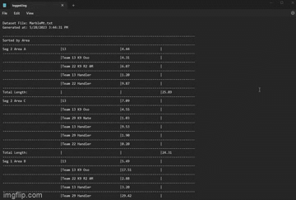
Final Deliverable -- GUI

Slide 33
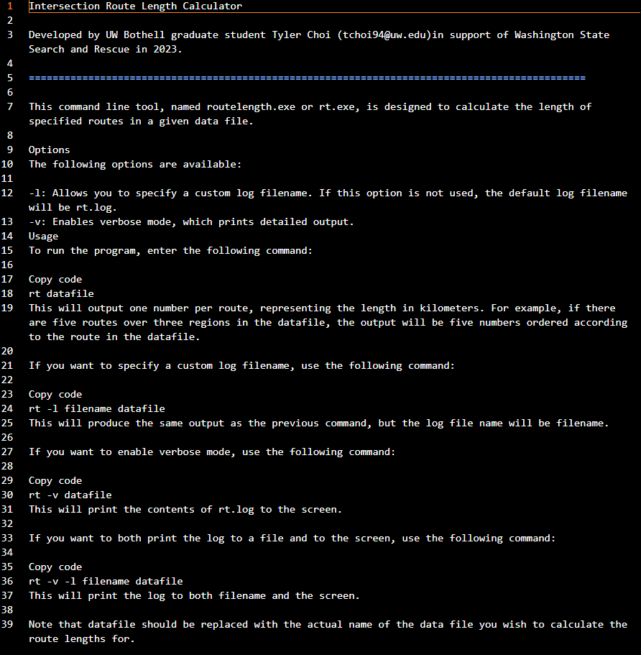
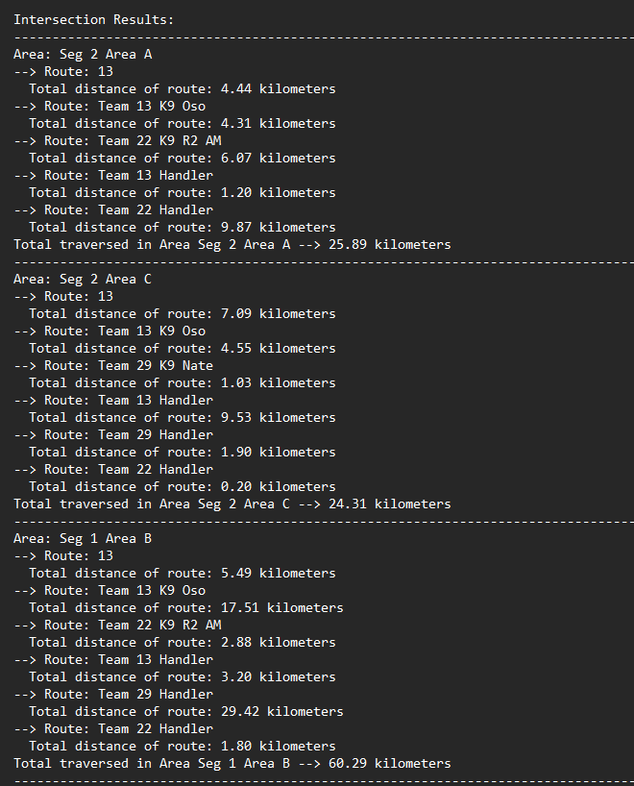
User Support

Slide 34

Results
Simplicity
Offline Availability
Low Overhead
Speed
Utility-focused
A simple application that frontline personnel need. Given a GPS track of a search path and area, the built system outputs the traversed distance within the search area.
Notes:
ensuring easy usage under stressful, time-sensitive situations typical of SAR missions
accommodating the need for functionality in areas with limited or no internet connectivity - a common challenge for SAR command posts
ensuring it does not burden the limited computational resources available during SAR operations
facilitating real-time decision-making and enhancing the effectiveness of SAR operations
and aids decision-making for SAR personnel, with a primary focus on utility and efficiency

Slide 35



Testimonial
"The application developed by Tyler Choi at the University of Washington will greatly reduce the amount of time it takes to process GSP tracks during active search and rescue missions, when it is needed most.
It works offline, which is important because often there is no internet connectivity at the Command Post of a SAR mission, and it is quick and easy to use, saving a lot of time and effort.
Using this application will allow search planners on scene at command post to calculate probabilities in time for planning the next Operational Period, which is something very challenging to do now, and ultimately could help find the lost subject quicker and potentially save lives."
- Eric R. Director, WA SAR Planning Unit

Slide 36
UCD Reflections (4)
Impact of User-Centered Design
User Adoption
Improved Efficiency
Error Reduction
Key Takeaways
Emphasize the End-User
Value of UCD
Notes:
Through implementing UCD, we designed software that directly addresses the needs of the end-user, promoting user adoption and satisfaction.
By streamlining the design based on users' workflows, we've reduced the amount of time and effort required to achieve desired outcomes.
: The design, structured around user needs and intuitive usability, mitigates the chance of user error and ensures smoother operation.
The process underscored the importance of focusing on the end-user when designing software.
: UCD isn't just a theoretical concept; it has tangible, real-world benefits that can enhance the utility and effectiveness of software.

Slide 37
Progress
VR ITM
SAR GUI/CLI
1
5
2
3
4
September 2022
May
2023
UCD Pivot

Slide 38
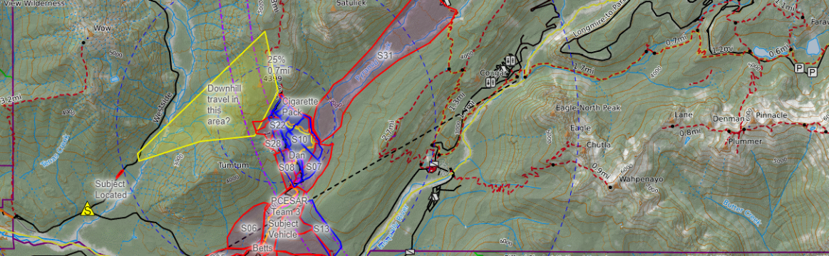
Limitations
Data Robustness:
Testing based on a limited number of datasets.
Future evaluations should use diverse datasets for wider applicability.
Continuous Iteration:
Embrace the UCD approach; continue refining software based on broader test data and user feedback.

Slide 39
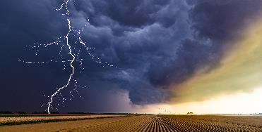


Future Work
UCD with WaSAR to be continued
Land Classification Model & Current Terrain Situation
Computation of Average Speed
Automatic Separation of Region by Land Classification
Searchable Regions

Slide 40

Conclusion
Developed a software tool with a user-centered design approach, enhancing Search and Rescue (SAR) operations.
Successfully addressed key pain points through innovative and iterative solutions, optimized for rapid and efficient data processing.
Validated utility and robustness of the system through user feedback and real-world application.
Deepened understanding of iterative research and development in new technologies.
Demonstrated profound impact of User-Centered Design on real-world utility software.
Notes:
Looking Ahead:
Committed to continual refinement and iteration of the software, in line with UCD principles, for more effective SAR operations.
Final Note:

Slide 41



Acknowledgements
THANK YOU
Professor Kelvin Sung (Advisor, Chair)
Dir. Eric R. (End-User)
Professor Michael Stiber (Committee)
Professor Yusuf Pisan (Committee)
University of Washington Bothell
Family and friends

Slide 42

Q&A

